Slide 1
SMART HOME USING SENSORS

Slide 2
SENSOR
A sensor is a device that detects the change in the environment and responds to some output on the other system.
A sensor converts a physical phenomenon into a measurable analog voltage (or sometimes a digital signal) converted into a human-readable display or transmitted for reading or further processing

Slide 3
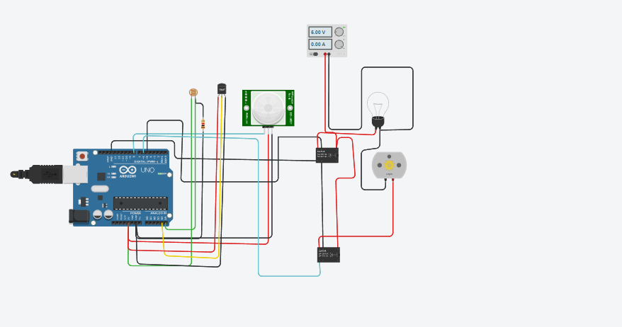
SMART HOMECIRCUIT

Slide 4
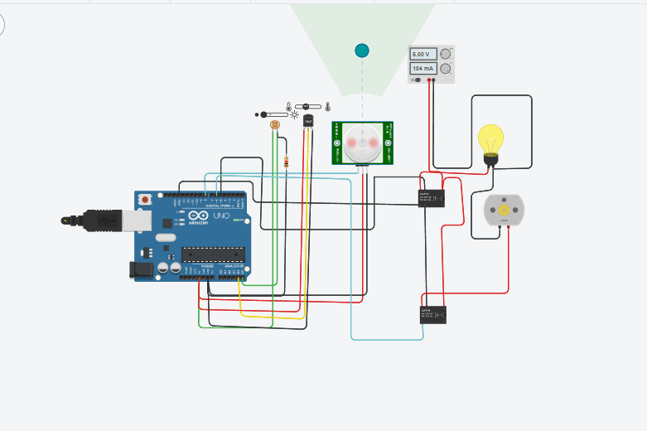
DURING NIGHT TIME

Slide 5
DURING NIGHT TIME
The bulb is on condition during night time .
The temperature sensor is more tha 30 degree celsius the fan is turn on.

Slide 6
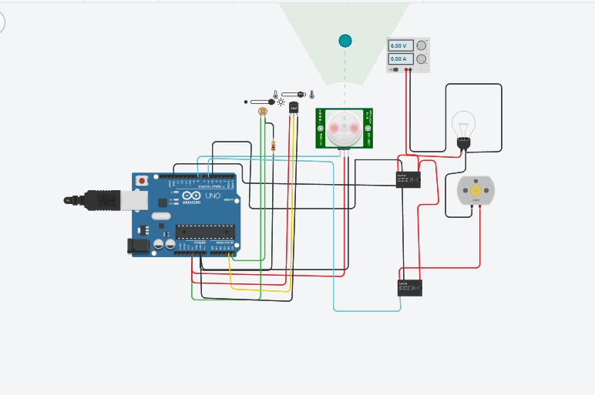
DURING DAY TIME

Slide 7
DURING DAY TIME
The bulb is off condition during day time .
The temperature sensor is 117degree celsius the fan is turn on.

Slide 8
SIMULATION PROGRAM
float x,y,z,temp;
void setup()
{
pinMode(8, INPUT);
pinMode(5, OUTPUT);
pinMode(6, OUTPUT);
pinMode(A5, INPUT);
pinMode(A4, INPUT);
Serial.begin(9600);
}
void loop()
{
x= digitalRead(8);
y= analogRead(A5);
z= analogRead(A4);
Serial.println(x);

Slide 9
PROGRAM
Serial.println(y);
Serial.println(z);
temp = (double)z / 1024;
temp = temp * 5;
temp = temp - 0.5;
temp = temp * 100;
if ( (x>0) )
{
if ((y<550)&&(temp>30))
{
digitalWrite(5, HIGH);
digitalWrite(6, HIGH);
}
else if((y<550)&&(temp<30))

Slide 10
PROGRAM
{
digitalWrite(5, HIGH);
digitalWrite(6, LOW);
}
else if((y>550)&&(temp>30))
{
digitalWrite(5, LOW);
digitalWrite(6, HIGH);
}
else if((y>550)&&(temp<30))
{
digitalWrite(5, LOW);
digitalWrite(6, LOW); }
}
else {
digitalWrite(5, LOW);
digitalWrite(6, LOW);
}
}

